Slide 1

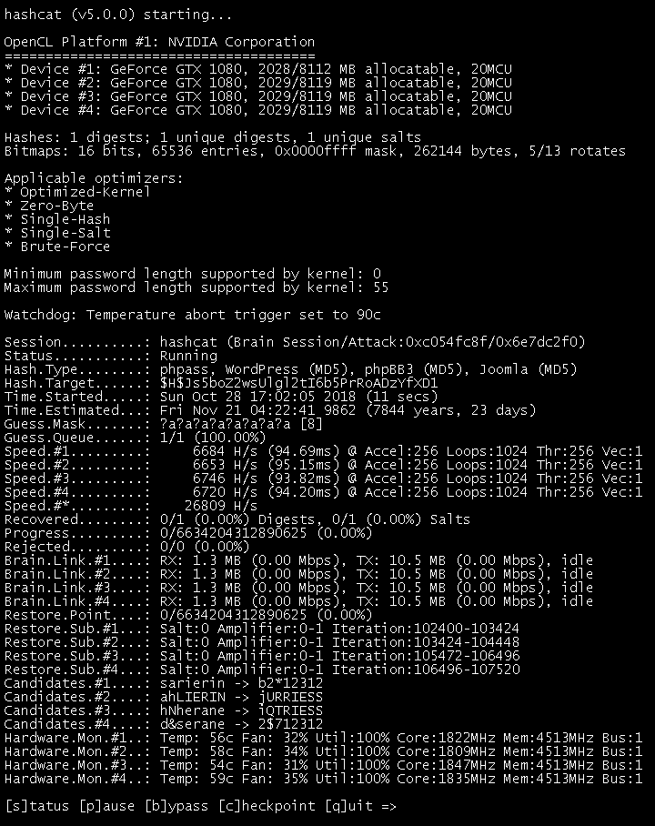

How to Hack Action Cameras
Konrad Iturbe - 2019
[H&B Madrid]
Twitter: @konrad_it

Slide 2
Index
Personal Intro + intro to GoPro
Pwning cameras ‘out of the box’ style:
A brief teardown / FW reverse engineering
Hacking: Enhancing possibilities and having fun drifting during the night
A look at the WiFi API
Hacking: BT leakage
Hacking: Risks of autogenerated pseudorandom passwords
Mitigations, etc… for people who need maximum OPSEC
Ending words, advisories, all the sources,
Looking at other action cameras/drones
[H&B Madrid]
Twitter: @konrad_it

Slide 3
Konrad Iturbe:
Former Android developer, now full stack React Native dev
Has worked reverse engineering cameras and drones for private companies, government agencies, military...
As seen on hackaday, cnet, the verge, etc...
[H&B Madrid]
Twitter: @konrad_it

Slide 4

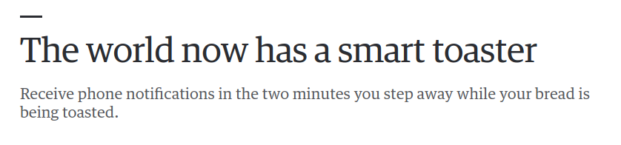
The era of connected devices, and their associated risks

Slide 5
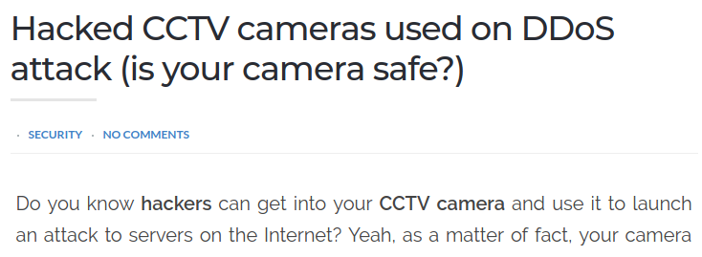
The era of connected devices, and their associated risks

Slide 6
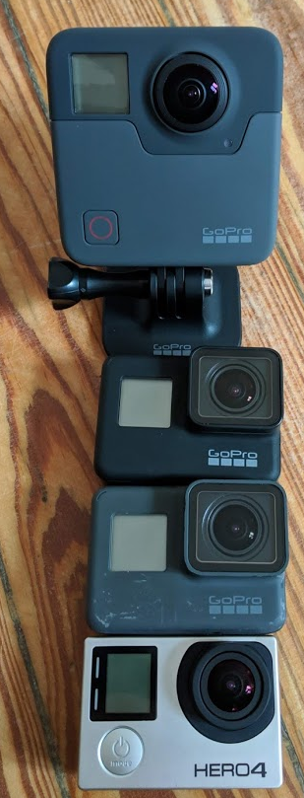
What is even a GoPro?
Small camera used for actions sports, military, cinema, vacations…
Payload in flash memory: HD video, photos, camera serial identifier, GPS/accel metadata
Data accessed via WiFi: live view w/ audio, SD card access
Peripherals: PC (USB/Sdcard), Phone (WiFi)
Attack vectors: WiFi, BT-LE, ...sd card? lol
[H&B Madrid]

Slide 7
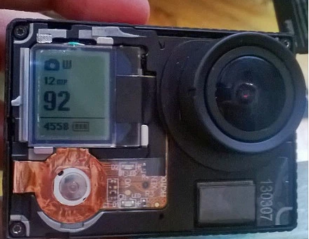
What’s inside a GoPro
SoC:
HERO1...5: Ambarella chipset, usually the latest A* (H4:A7, H5: A9)
HERO6, 7: Custom SoC made exclusively for GoPro by SocioNEXT
WiFi / BT-LE:
QCOM ATHEROS WIFI and BTLE chip
Optics:
usually a Sony sensor
Sensors:
HERO5 and newer: GPS, accel, x/y/z gyroscope
Inputs: USB (Hero5 newer: TypeC, older: Mini USB) supports accessories, HDMI
Flash:
Uses a exFAT/FAT32 SD card for media storage and FW flashing
[H&B Madrid]

Slide 8
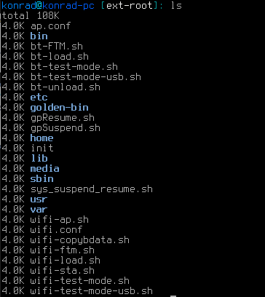
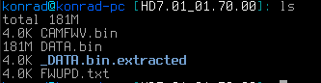
But what makes the camera tick?
Two firmwares:
AMBA FW: Section-divided .bin file,no tiny OTA support, flash from SD card, CRC matched before flash deals with all front end, image capture...
Linux Cherokee Server: EXT linux partition deals with WiFi, USB, BT, file server for HTTP API
CAMFWV = loader
DATA = Cherokee linux + AMBA

Slide 9
$ whoami === root
Camera boot process used to have a step for executing a file called autoexec.ash in the sdcard
Executed from the AMBA side, meaning we get access to proprietary commands like t, firmfl, savebin… and some standard UNIX commands (rm, mv, …) AND supports statically-compiled busybox
Read/write priv to sd card, a:\ sector (binary, etc…)
Bridge to RTOS using lu_util
[H&B Madrid]
Twitter: @konrad_it

Slide 10
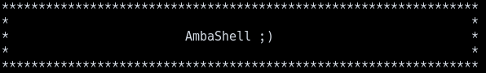
$ whoami === root
Camera boot process used to have a step for executing a file called autoexec.ash in the sdcard
Executed from the AMBA side, meaning we get access to proprietary commands like t, firmfl, savebin… and some standard UNIX commands (rm, mv, …) AND supports statically-compiled busybox
Read/write priv to sd card, a:\ sector (binary, etc…)
Bridge to RTOS using lu_util
[H&B Madrid]
Twitter: @konrad_it

Slide 11
$ whoami === root
Camera boot process used to have a step for executing a file called autoexec.ash in the sdcard
Executed from the AMBA side, meaning we get access to proprietary commands like t, firmfl, savebin… and some standard UNIX commands (rm, mv, …) AND supports statically-compiled busybox
Read/write priv to sd card, a:\ sector (binary, etc…)
Bridge to RTOS using lu_util
HERO3+ and lower only!
[H&B Madrid]
Twitter: @konrad_it

Slide 12
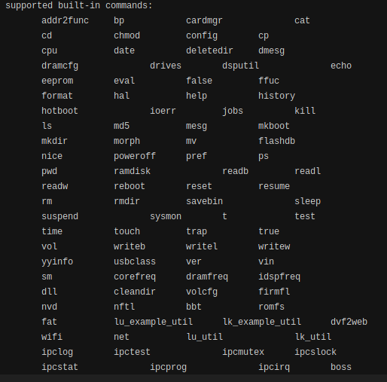
$ whoami === root
Camera boot process used to have a step for executing a file called autoexec.ash in the sdcard
Executed from the AMBA side, meaning we get access to proprietary commands like t, firmfl, savebin… and some standard UNIX commands (rm, mv, …) AND busybox
Read/write priv to sd card, a:\ sector (binary, etc…)
Bridge to RTOS using lu_util
HERO3+ and lower only!
[H&B Madrid]
Twitter: @konrad_it

Slide 13
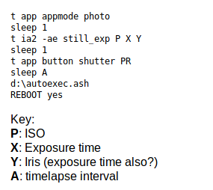
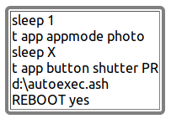
Enhancing capabilities
For example, to enable a root shell via WiFi on HERO3 cameras:
lu_util exec 'telnetd -l /bin/sh -p 80'
More commands can enable the camera to do:
- long exposures
- longer timelapses
- automatically turn on wifi
FULL CREDIT FOR AUTOEXEC.ASH GOES TO EVILWOMBAT!!!!
And much more (check github for recipes)
[H&B Madrid]
Twitter: @konrad_it

Slide 14

Enhancing capabilities
For example, to enable a root shell via WiFi on HERO3 cameras:
lu_util exec 'telnetd -l /bin/sh -p 80'
More commands can enable the camera to do:
- long exposures
- longer timelapses
- automatically turn on wifi
FULL CREDIT FOR AUTOEXEC.ASH GOES TO EVILWOMBAT!!!!
[H&B Madrid]
Twitter: @konrad_it
Photo credit: BW900 on reddit

Slide 15

Enhancing capabilities
For example, to enable a root shell via WiFi on HERO3 cameras:
lu_util exec 'telnetd -l /bin/sh -p 80'
More commands can enable the camera to do:
- long exposures
- longer timelapses
- automatically turn on wifi
FULL CREDIT FOR AUTOEXEC.ASH GOES TO EVILWOMBAT!!!!
[H&B Madrid]
Twitter: @konrad_it
Photo credit: DesignNomad on reddit

Slide 16

Enhancing capabilities
For example, to enable a root shell via WiFi on HERO3 cameras:
lu_util exec 'telnetd -l /bin/sh -p 80'
More commands can enable the camera to do:
- long exposures
- longer timelapses
- automatically turn on wifi
FULL CREDIT FOR AUTOEXEC.ASH GOES TO EVILWOMBAT!!!!
[H&B Madrid]
Twitter: @konrad_it
My attempt :D

Slide 17

Enhancing capabilities
For example, to enable a root shell via WiFi on HERO3 cameras:
lu_util exec 'telnetd -l /bin/sh -p 80'
More commands can enable the camera to do:
- long exposures
- longer timelapses
- automatically turn on wifi
FULL CREDIT FOR AUTOEXEC.ASH GOES TO EVILWOMBAT!!!!
[H&B Madrid]
Twitter: @konrad_it

Slide 18
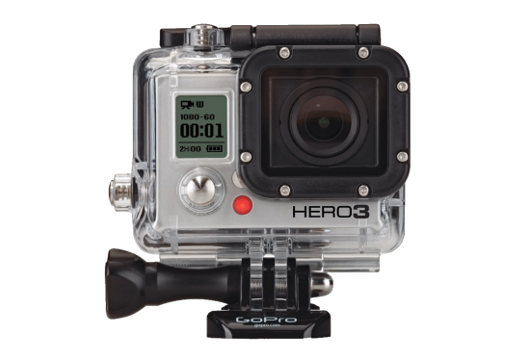
Enhancing capabilities
For example, to enable a root shell via WiFi on HERO3 cameras:
lu_util exec 'telnetd -l /bin/sh -p 80'
More commands can enable the camera to do:
- long exposures
- longer timelapses
- automatically turn on wifi
FULL CREDIT FOR AUTOEXEC.ASH GOES TO EVILWOMBAT!!!!
All photos shot on hacked Hero3 Black cameras!
[H&B Madrid]
Twitter: @konrad_it

Slide 19
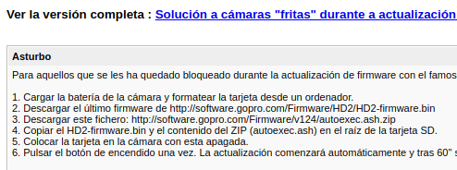
Hacking as a way to solve problems:
Using autoexec.ash ‘evilwombat’ managed to unbrick HERO2 cameras, props to him!
It loaded a new firmware to the correct section and then wiped a certain part of the flash memory.
Then GoPro came up with their solution:
[H&B Madrid]
Twitter: @konrad_it

Slide 20
From Zero To Hero
Pre-made scripts can be found on my github repo: https://github.com/konradit/autoexechack
GoPro Long Exp code: http://chernowii.com/gopro-longexp
Long intervals in timelapse: http://chernowii.com/megalapse
DEF CON 21 presentation with more in-depth info on HERO3 hacking: GoPro or GTFO: A Tale of Reversing an Embedded System
[H&B Madrid]
Twitter: @konrad_it

Slide 21
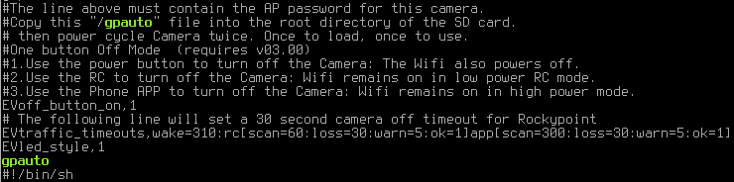
Out with the old… In with the new!
GoPro HERO4 and newer now load a new filename called gpauto at boot!
Executable script has the following structure:
Thx gopro
[H&B Madrid]
Twitter: @konrad_it

Slide 22
Supported commands on gpauto
EV*:
EVssidprimary (changes SSID)
Evpassphrase (changes password)
EVoff_button_on (enables One Button Off mode)
...
camera/backpack HERO3-style commands! (More on this later)
[H&B Madrid]
Twitter: @konrad_it

Slide 23
Hacking the WiFi API
Cameras include WiFi functionality to connect to the smartphone app
WiFi: WPA2, password protected
Static IP: 10.5.5.9, standard DHCP gateway 255.255.255.0
Ports: 80/8080 for HTTP requests (command, status, media query) and live stream
Cherokee server on Linux partition mounts d:\ (sd card) to /tmp/fuse_d
then mounts /tmp/fuse_d/DCIM to /var/ww/videos
Camera_model =<HERO3+:
WiFi streaming: http://10.5.5.9:8080/live/amba.m3u8
Camera_model <HERO3+:
WiFi streaming: udp://{10.5.5.9 … 11}:8554
[H&B Madrid]
Twitter: @konrad_it

Slide 24
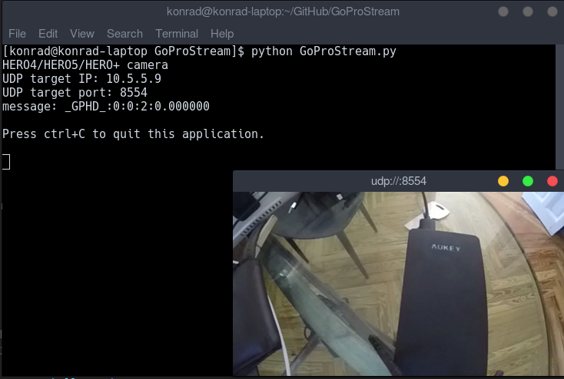
Hacking the WiFi API
Live streaming is possible!
Cameras include WiFi functionality to connect to the smartphone app
WiFi: WPA2, password protected
Static IP: 10.5.5.9, standard DHCP gateway 255.255.255.0
Ports: 80/8080 for HTTP requests (command, status, media query) and live stream
Cherokee server on Linux partition mounts d:\ (sd card) to /tmp/fuse_d
then mounts /tmp/fuse_d/DCIM to /var/ww/videos
Camera_model =<HERO3+:
WiFi streaming: http://10.5.5.9:8080/live/amba.m3u8
Camera_model <HERO3+:
WiFi streaming: udp://{10.5.5.9 … 11}:8554
[H&B Madrid]
Twitter: @konrad_it

Slide 25

WiFi commands: Taking GoPro to a truly PRO level
Wireless API “auth” HERO2..HERO3+:
Command API:
URI base: http://10.5.5.9/
+ camera OR bacpac
+ /{parameter}
+ ?t=PASSWORD
+&p=%{option}
Password can be obtained via:
HTTP GET http://10.5.5.9/bacpac/sd
$Parameter - $option list:
/bacpac/:
PW - 00 Turn GoPro OFF
PW - 01 Turn GoPro ON
RS - Reset bacpac
SH - 01 Shutter
SH - 00 Stop
/camera/:
CM - 00 Video Mode
CM - 01 Photo Mode
CM - 02 Burst Mode
CM - 03 Timelapse Mode
And all of the camera settings available (video resolution, photo resolution, timelapse interval, auto off, etc…)
No WiFi === UNHACKABLE
For example: to take a photo or start a video:http://10.5.5.9/bacpac/SH?t=MySecurePassword&p=%01
[H&B Madrid]
Twitter: @konrad_it

Slide 26
WiFi commands: Taking GoPro to a truly PRO level
Wireless API “gpcontrol” HERO4 and newer:
Command API:
Base URI: http://10.5.5.9/gp/gpControl/
+ setting/{setting}/option
Or + command/{commandName} + option
Or + execute/{exeName}...
Changes compared to “auth” api:
no more authentication required, which was pointless.
Clearer endpoints
Shutter
Trigger: http://10.5.5.9/gp/gpControl/command/shutter?p=1
Stop (Video/Timelapse): http://10.5.5.9/gp/gpControl/command/shutter?p=0
Default Boot Mode:
Video: http://10.5.5.9/gp/gpControl/setting/53/0
Photo: http://10.5.5.9/gp/gpControl/setting/53/1
MultiShot: http://10.5.5.9/gp/gpControl/setting/53/2
Primary modes:
Video: http://10.5.5.9/gp/gpControl/command/mode?p=0
Photo: http://10.5.5.9/gp/gpControl/command/mode?p=1
MultiShot: http://10.5.5.9/gp/gpControl/command/mode?p=2
Tag moment:
Sends tag command: http://10.5.5.9/gp/gpControl/command/storage/tag_moment
…..
[H&B Madrid]
Twitter: @konrad_it

Slide 27
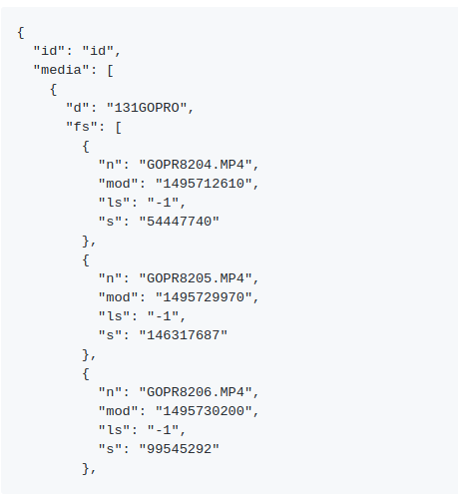
Media retrieval over WiFi
http://10.5.5.9/gp/gpMediaList
http://10.5.5.9/videos/DCIM/131GOPRO/GOPR8204.MP4
Supports download of JPEG, MP4, LRV (Low Resolution Videos)
HERO6 and newer cameras have WiFi 5ghz connection, so files can take seconds to download.
[H&B Madrid]
Twitter: @konrad_it

Slide 28
First vulnerability: SSID/Password leakage over BLE pairing
GoPro cameras require a one time pairing step with a smartphone. This step enables a BLE server with multiple characteristics, including the WiFi SSID and password of the camera. This step was designed so the user does not have to input anything, since the phone can pair via BT, get the password and connect to the camera.
[H&B Madrid]
Twitter: @konrad_it

Slide 29
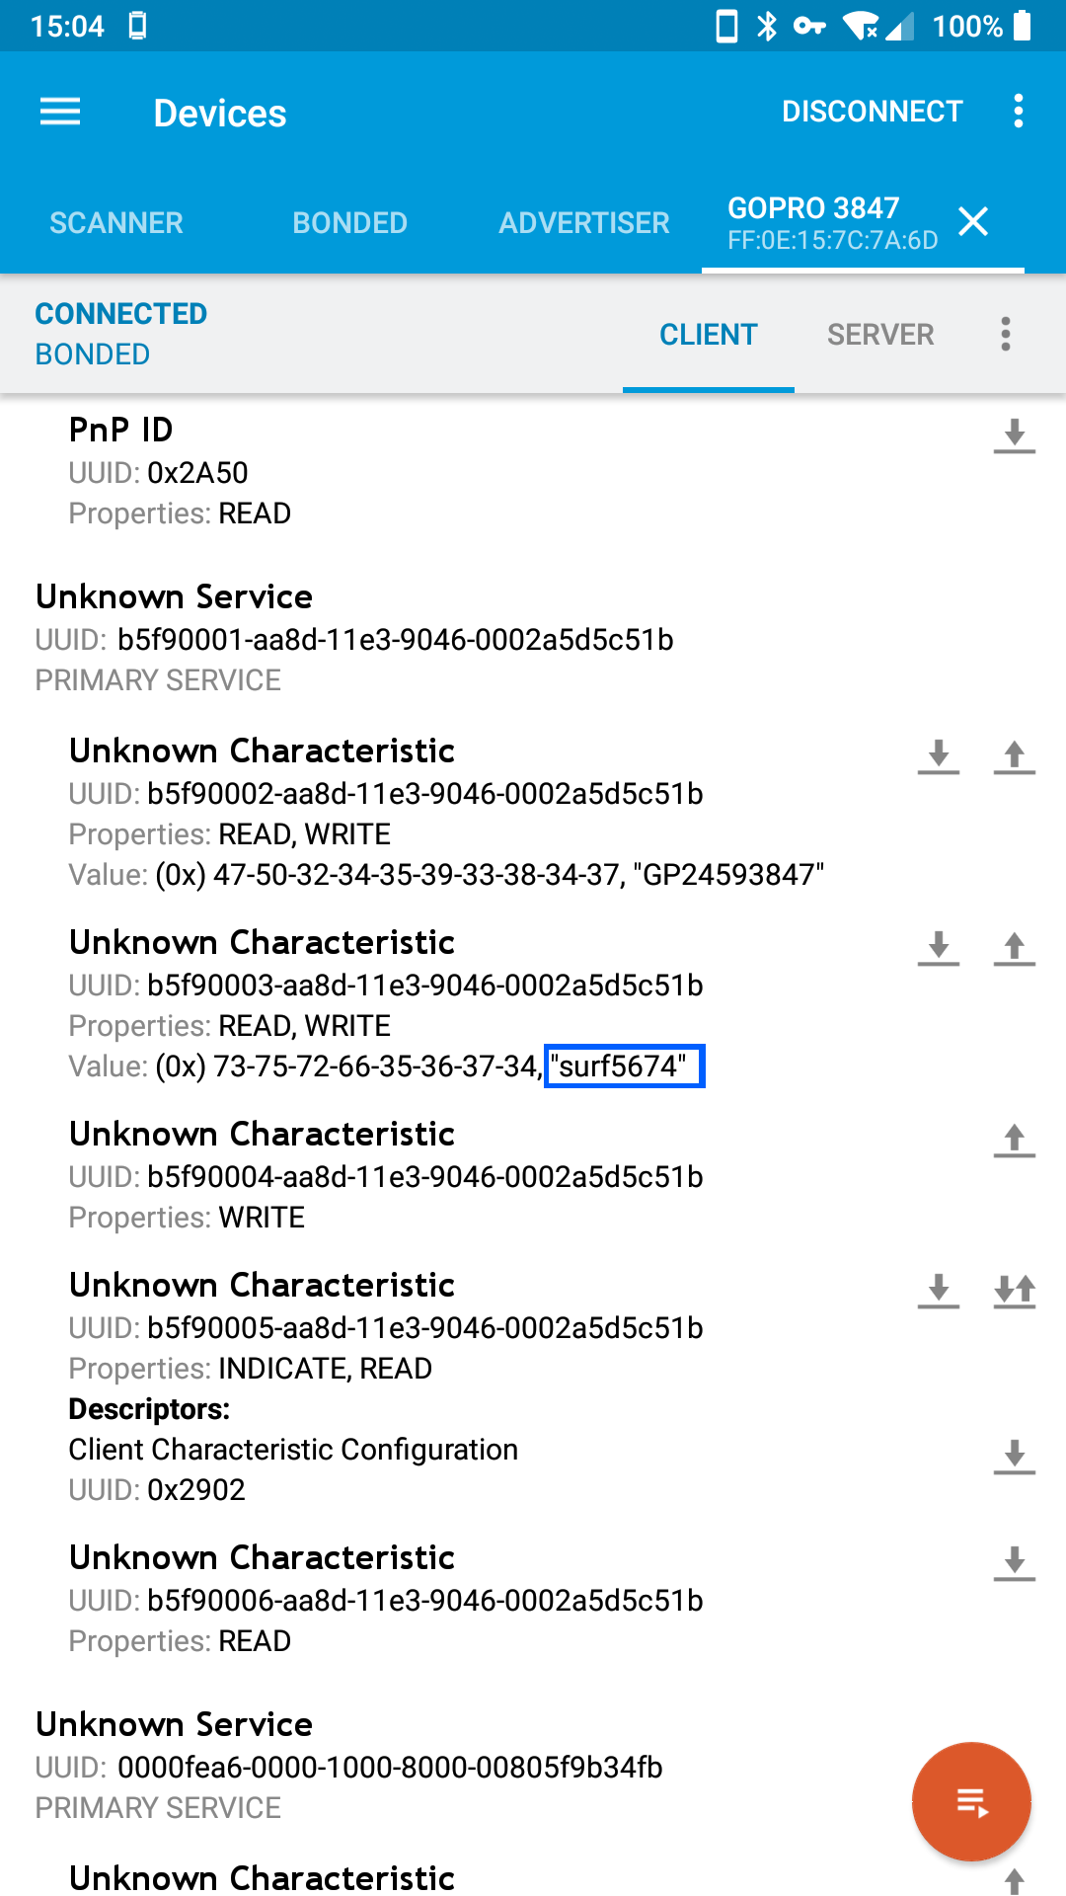
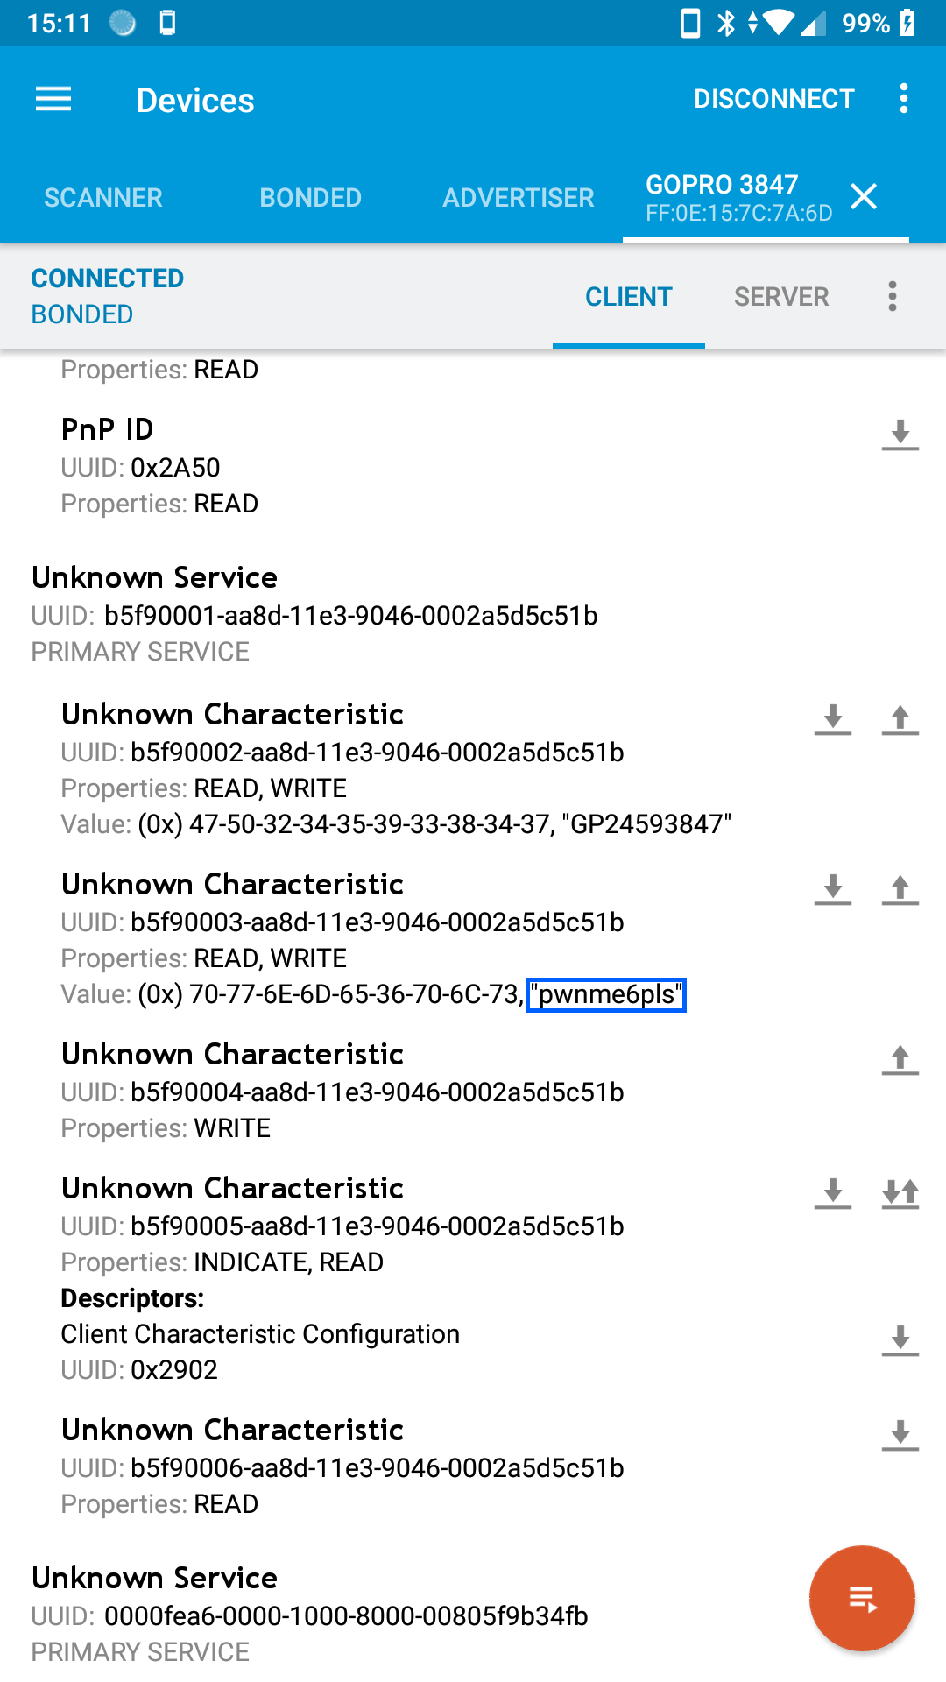
First vulnerability: SSID/Password leakage over BLE pairing
SSID and password are clearly visible to anyone who pairs to the camera (BLE pairing requires no authentication).
[H&B Madrid]
Twitter: @konrad_it

Slide 30
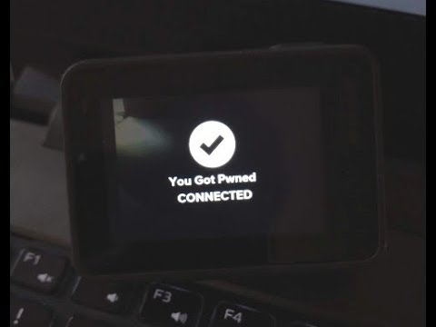
PoC time!

Slide 31
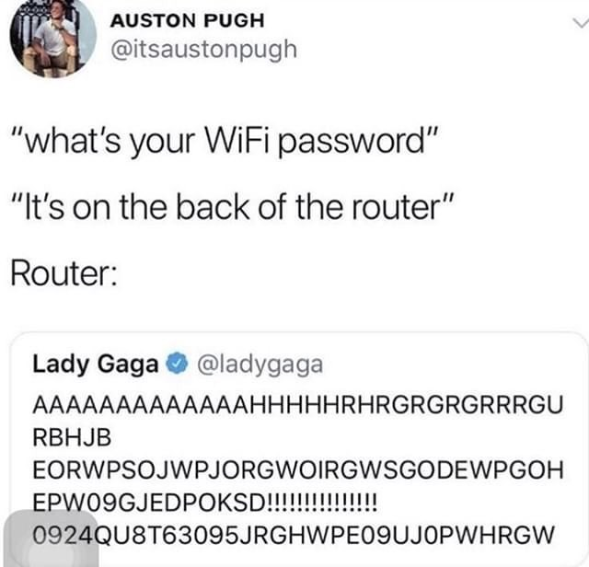
Auto-generated seemingly-high entropy passwords, are they safe?
[H&B Madrid]
Twitter: @konrad_it

Slide 32
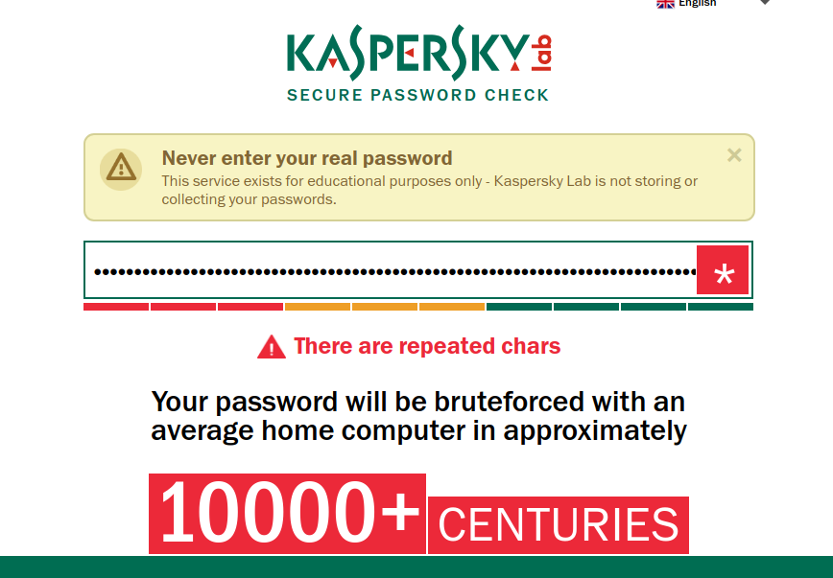
Auto-generated seemingly-high entropy passwords, are they safe?
[H&B Madrid]
Twitter: @konrad_it

Slide 33

Auto-generated seemingly-high entropy passwords, are they safe?
[H&B Madrid]
Twitter: @konrad_it

Slide 34
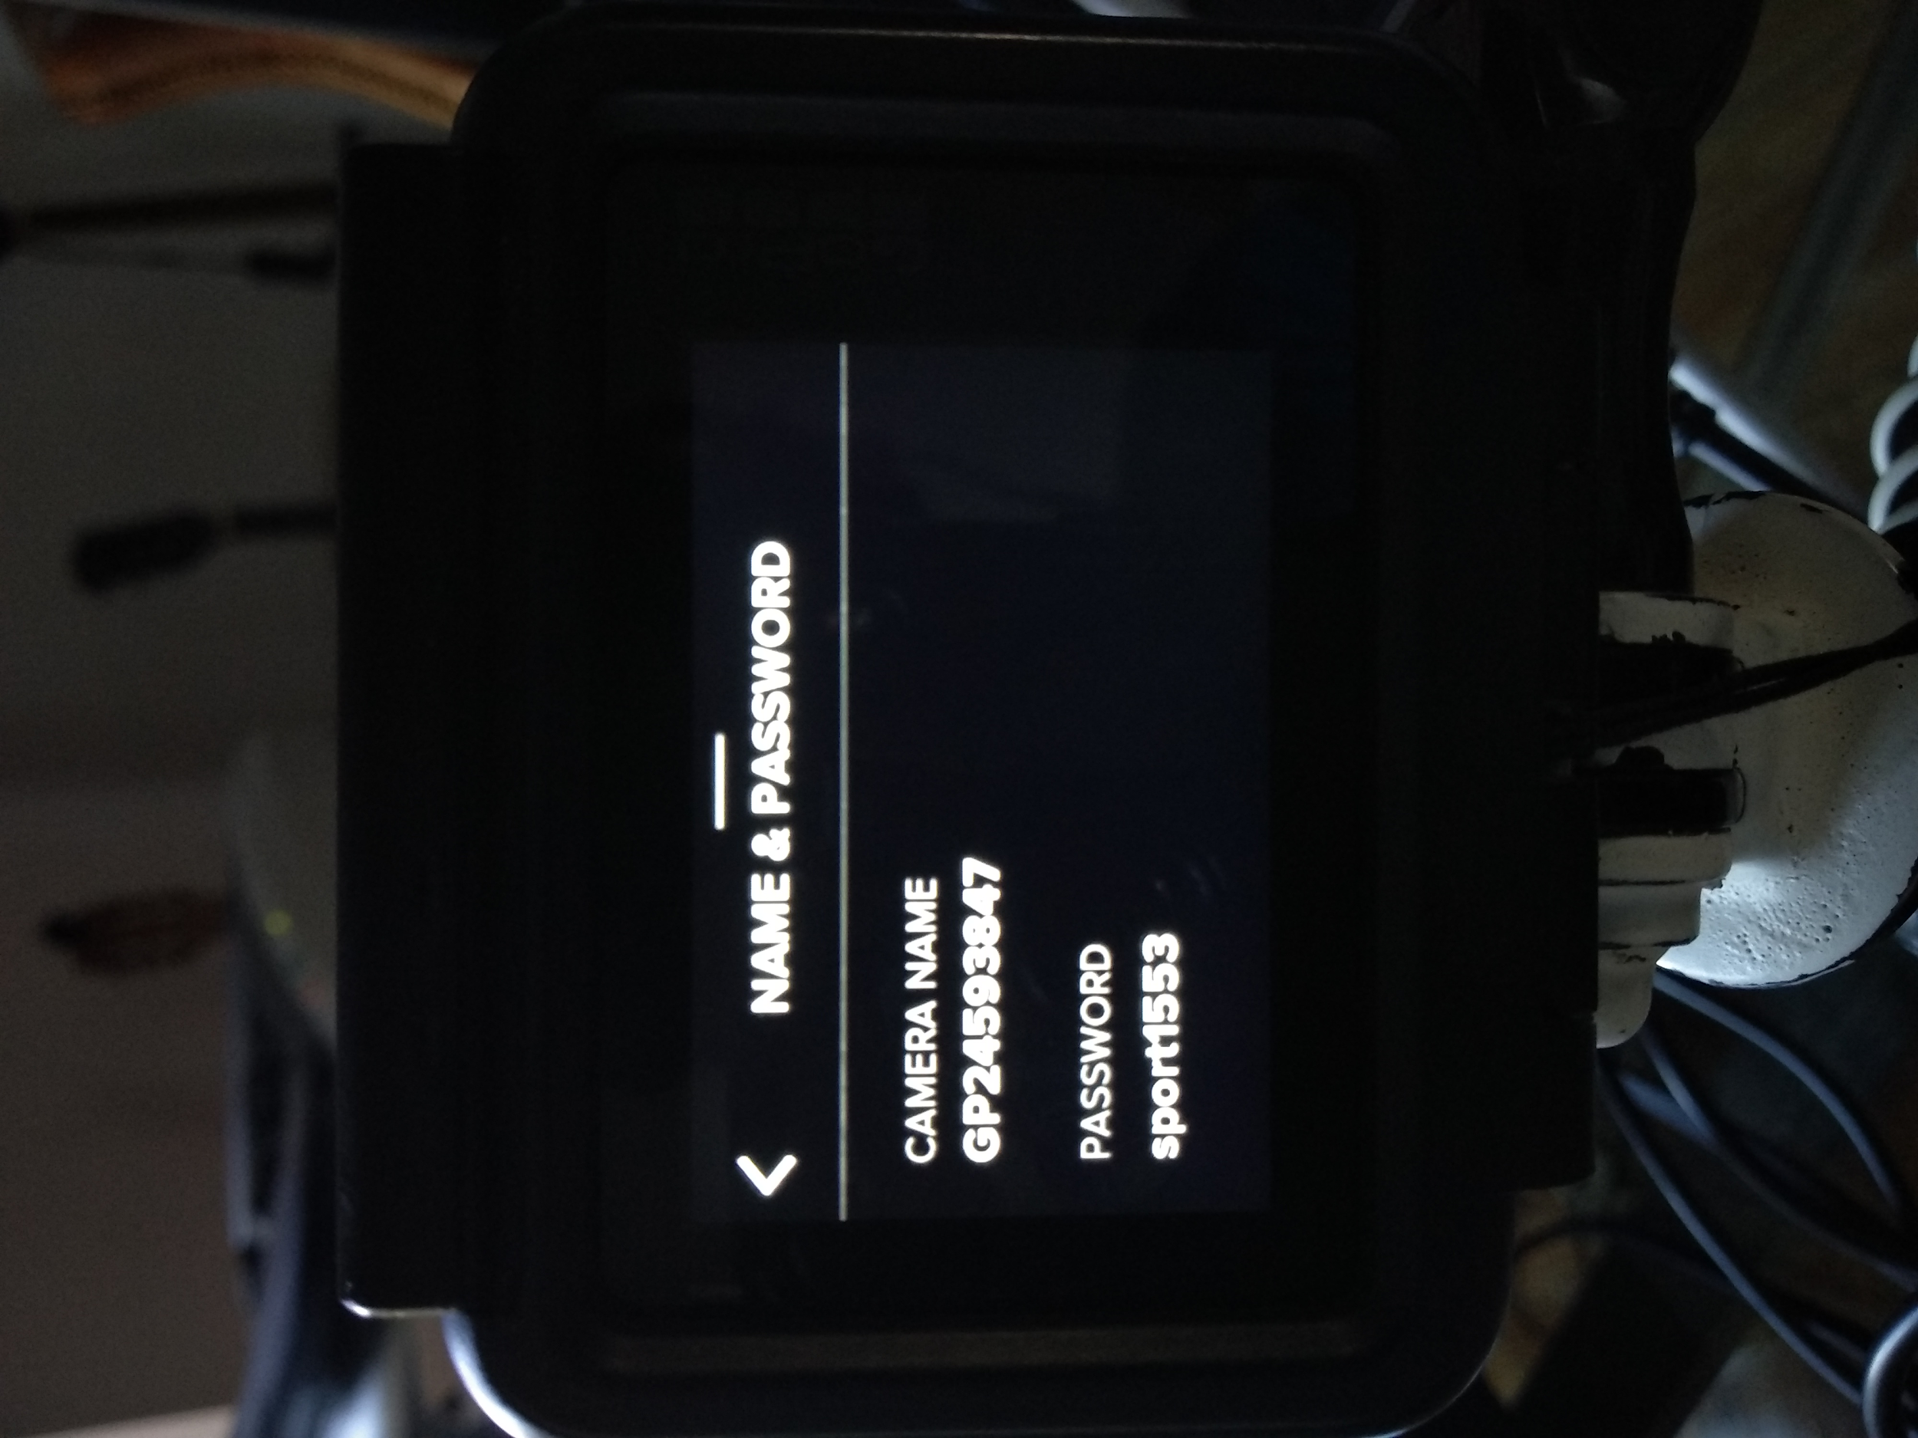
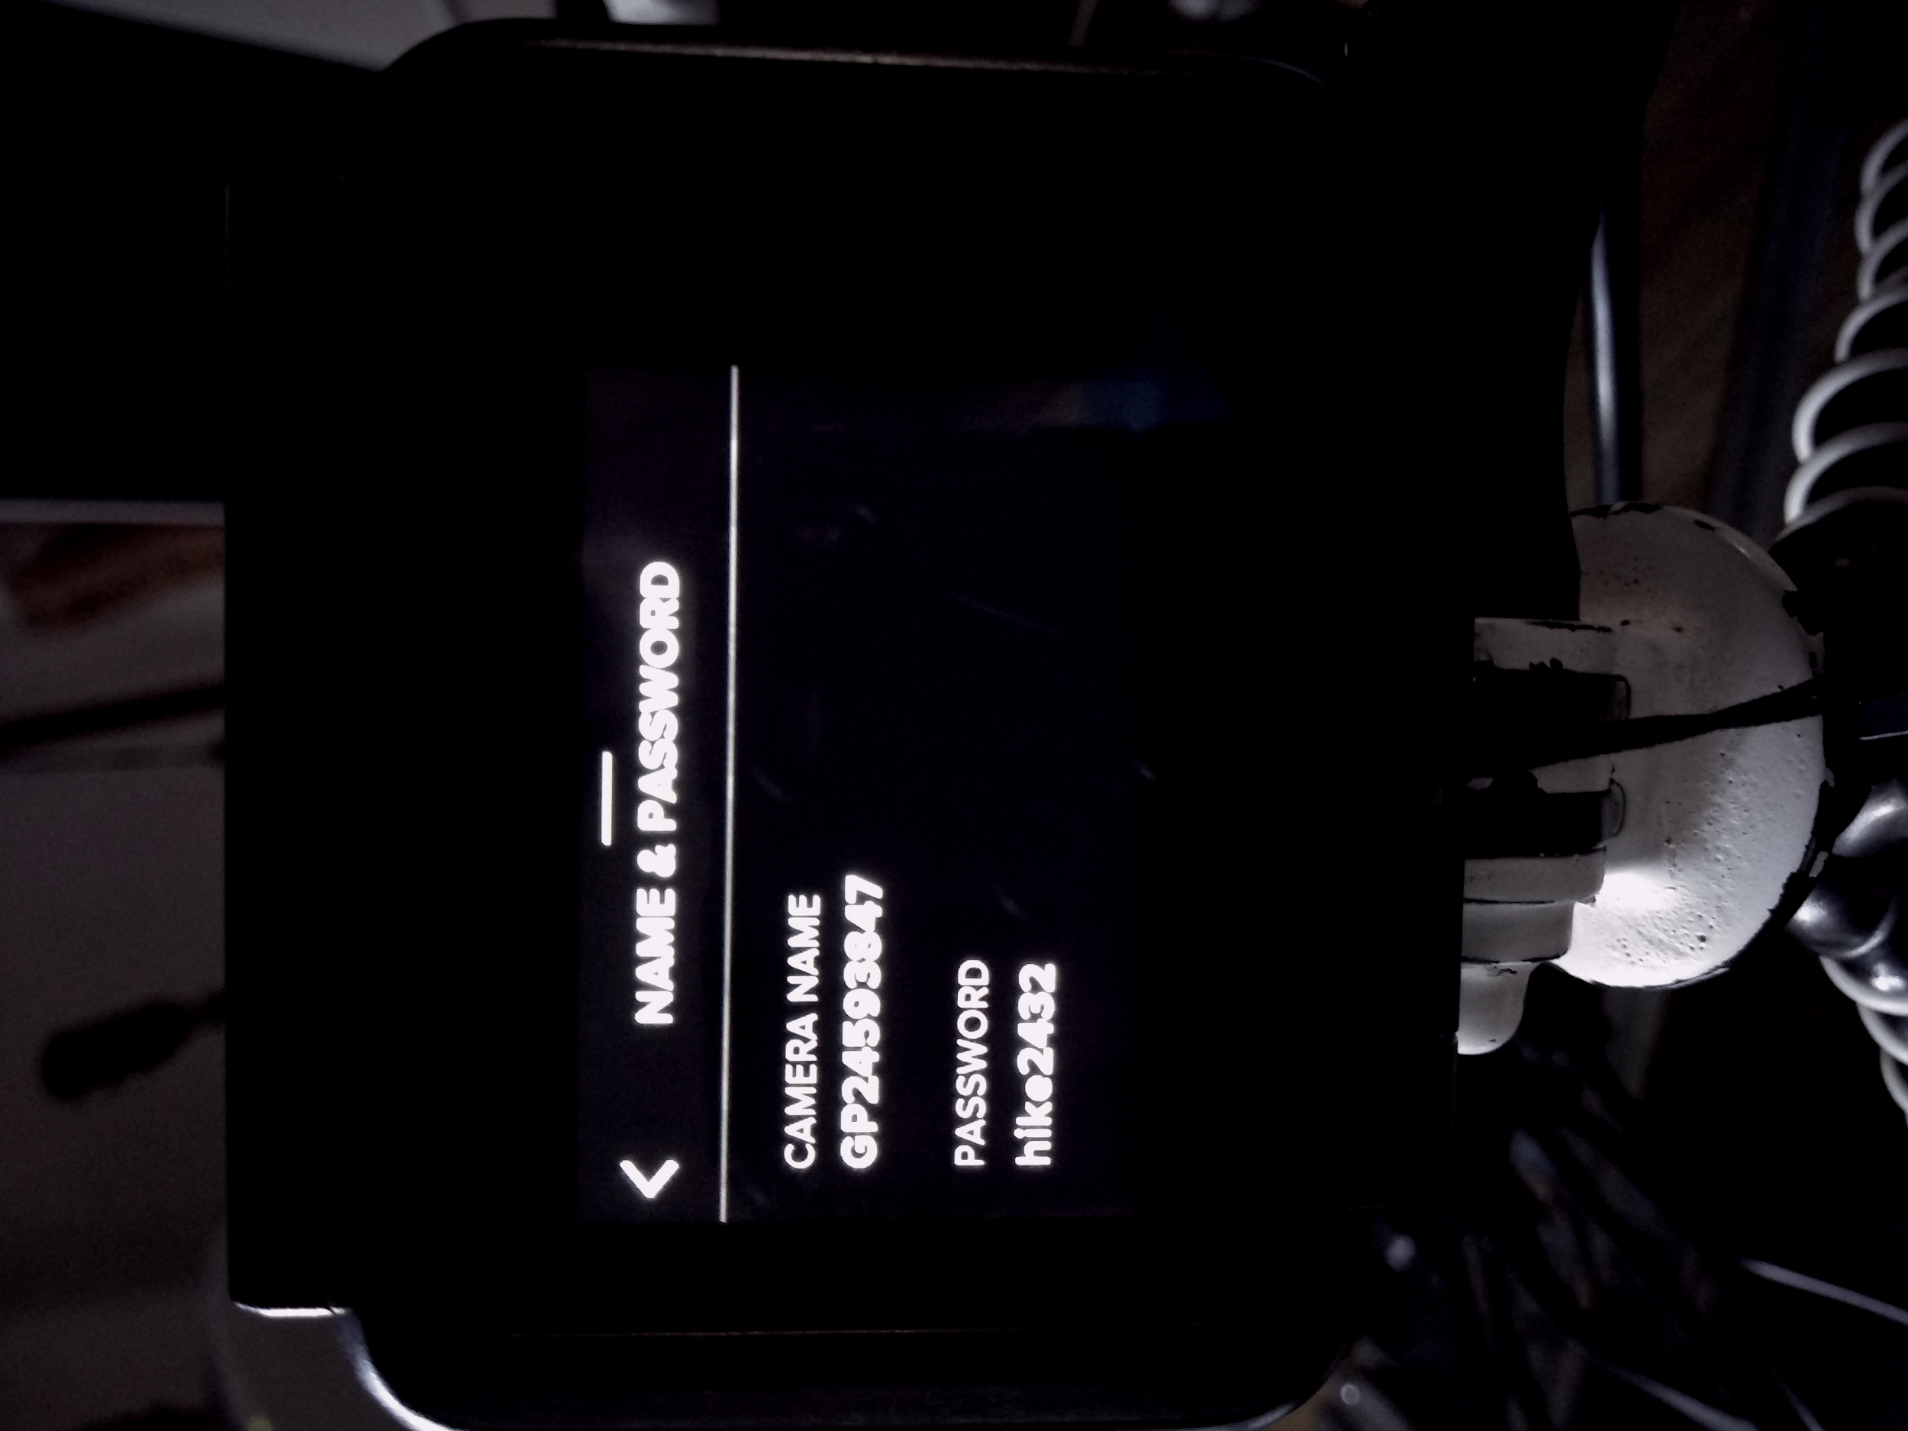
Auto-generated seemingly-high entropy passwords, are they safe?
GoPro WiFi password cannot be changed on HERO5 and newer cameras!
Problem is, the WiFi password is derived from a weak algorithm.

Slide 35
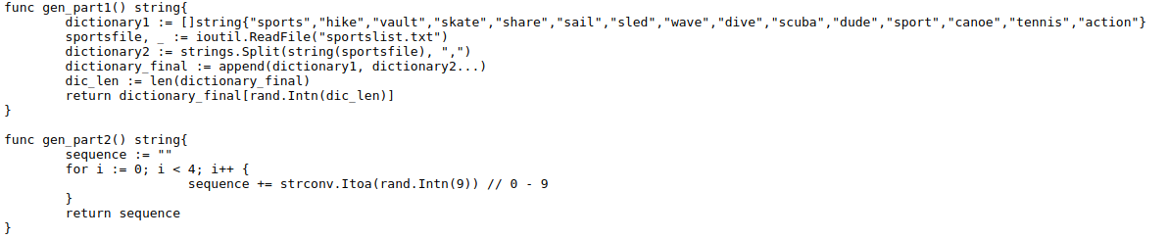
Auto-generated seemingly-high entropy passwords, are they safe?
Password layout is:
[word] + [number] + [number] + [number] + [number]
[H&B Madrid]
Twitter: @konrad_it

Slide 36
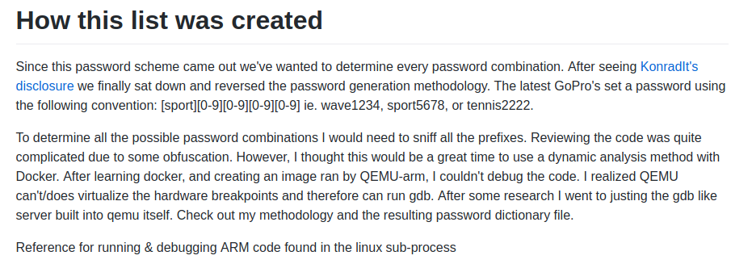
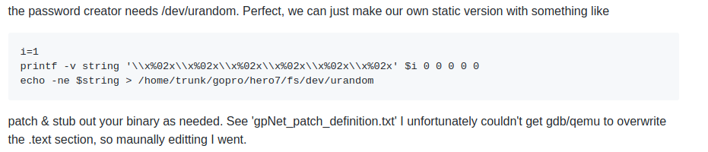
Auto-generated seemingly-high entropy passwords, are they safe?
Where are the words stored?
HYPOXIC did more research on this topic, binary ‘gpNet’ uses /dev/urandom to generate password internally. Make sure to check out his research as well!
Source: https://github.com/hypoxic/gopro-pwCreator
[H&B Madrid]
Twitter: @konrad_it

Slide 37
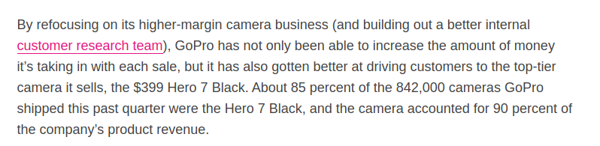
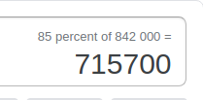
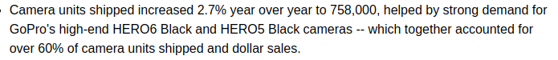
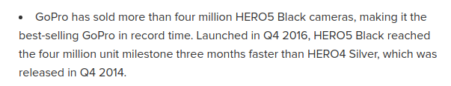
Auto-generated seemingly-high entropy passwords, are they safe?
Every HERO5, 6, 7 camera follows this password convention….
[H&B Madrid]
Twitter: @konrad_it

Slide 38
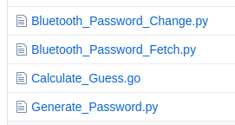
http://github.com/konradit/goprowirelesspassword
Everything you need to crack the passwords!!
[H&B Madrid]
Twitter: @konrad_it

Slide 39
Mitigation is 50% of attack vulnerability disclosure.
Multiple ways to mitigate this issue:
Don’t use WiFi. It drains battery and heats up the camera. Use an USB OTG reader or a USB cable for offloading media on the go, or HDMI for previewing.
Change WiFi SSID and Password:
gpauto:
cd $SD_CARD && ./code/GoPro_Password_Change.sh
Bluetooth:
put the GoPro in pairing mode and run code/Bluetooth_Password_Change.py
If you need OPSEC: Don’t turn WiFi, ever. Wipe your SD card regularly, use exiftool to remove GPS tags from photos, disable beeps and LEDs.
[H&B Madrid]
Twitter: @konrad_it

Slide 40
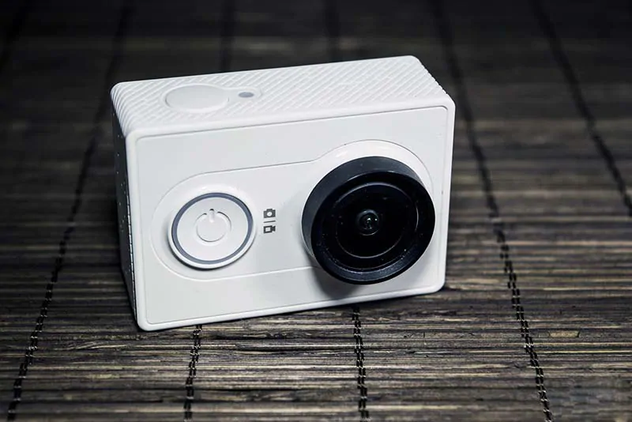
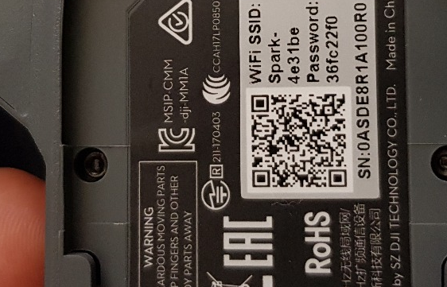
What about other action camera makers? Are those secure?
Yi: Default password for Yi cameras is 1234567890 but the password can be changed through the app!
DJI: WIFI password is decently secure, and it’s not detected by common equipment. RC remotes include WiFi to connect to the Android/iOS client, the default password for my Spark RC is 12341234 but it can be changed!

Slide 41
Moral of the story/TL;DPA
Use wireless connections if absolutely necessary, cables are good!
Default passwords, if unsecure, can put users at risk
People are willing to change the default password given it’s too hard, make it so that they to change it to something secure as well
Make password changes an optional step
[H&B Madrid]
Twitter: @konrad_it

Slide 42
The end…. for now!
[H&B Madrid]
Twitter: @konrad_it

